Slide 1
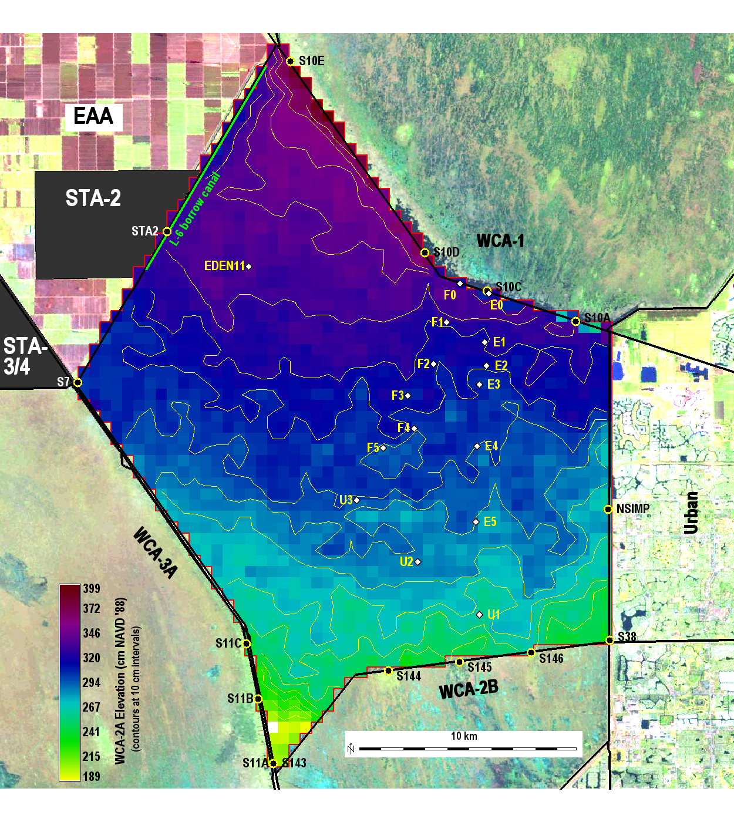
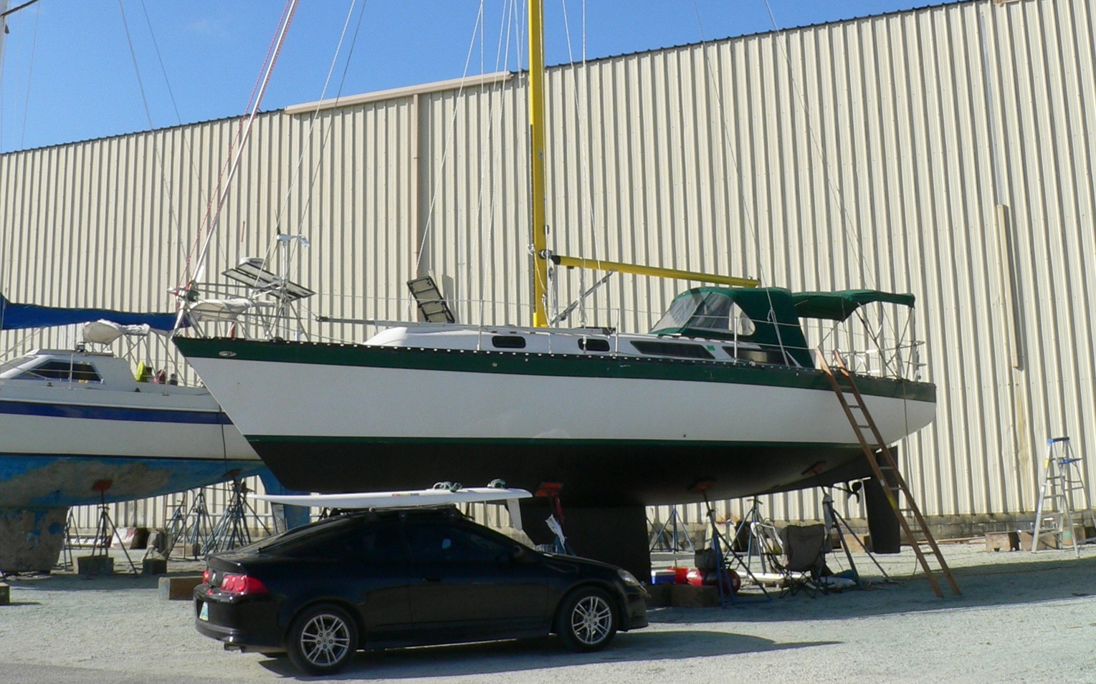
Wading Bird Habitat Suitability:
Everglades Landscape Model Applications
SFWMD final meeting
June16, 2015
H. Carl Fitz
EcoLandMod, Inc.
Some of the FCE &
related models

Slide 2
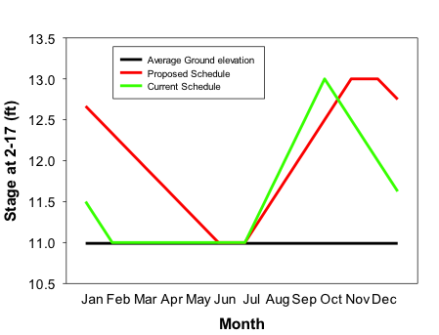
Project Goals
Evaluate ecological responses to changes in WCA-2A regulation schedule
How will soils respond?
How will vegetation respond?
How will wading birds respond?
Compare responses between current vs modified 2-17 gauge regulation schedule
Developed new wading bird suitability module
Used only hydrologic drivers for this iteration
Determine feasibility of integrating other ecological drivers
Exploratory “proof-of-concept” set of model experiments

Slide 3
ELMwca2a Application
Maps: WCA-2A basin, 500 m grid scale
Initial land elevation: 2003 USGS HAED 400 m data
Initial soils: Future scenarios - 2003 UF soil mapping project Historical calibration – 1991 Reddy, backward extrapolation
Initial cattail extent: Future scenarios – 2003 Zweig Historical calibration – 1982 Rutchey
Boundary conditions
Rainfall: Future scenarios - 1965-2000 SFWMM grid-IO Historical calibration – 1981-2000 SFWMM grid-IO
TP inflow concentrations: Future scenarios – fixed 10 ppb Historical calibration – 1981-2000 DBHydro observed data
Consumer (wading bird suitability) module
Used only hydrologic drivers for this iteration
Calculate 2-wk recession rate
Classify suitability of surface water depth, recession rates during bird breeding season

Slide 4
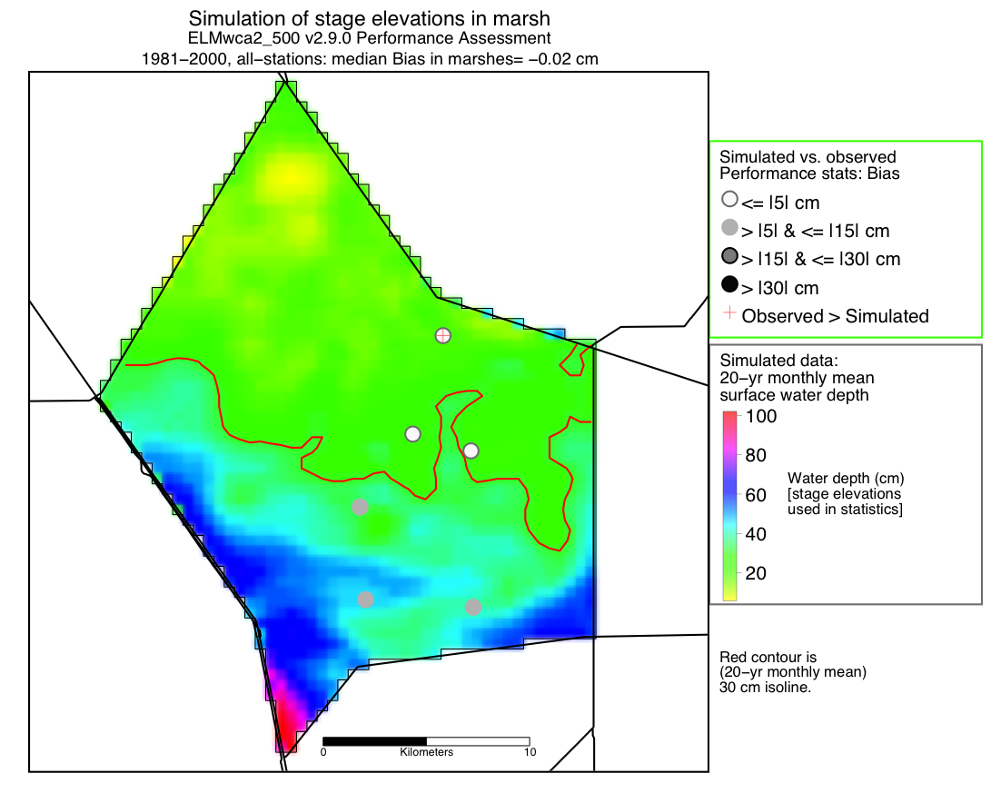
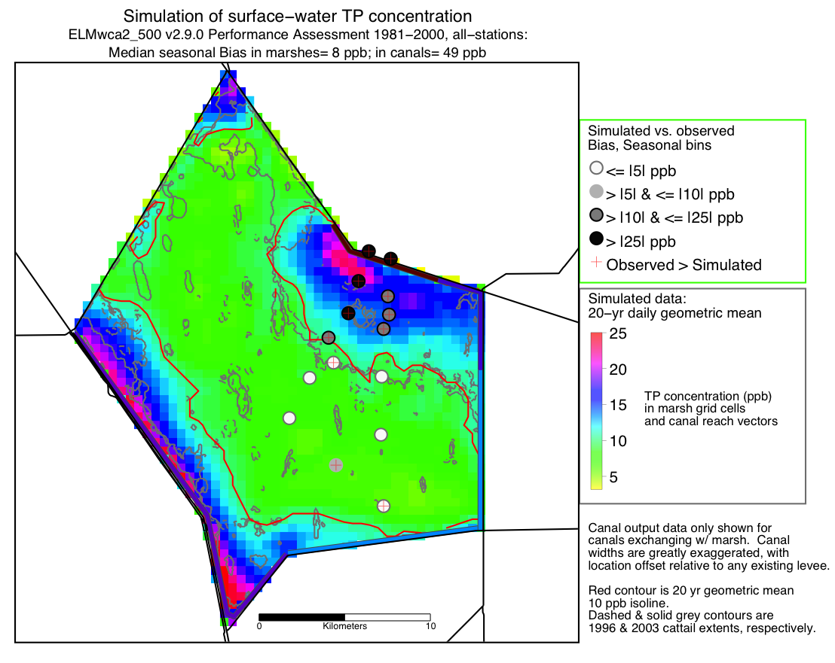
ELMwca2a Application
Surface water TP conc. calibration
Stage calibration

Slide 5
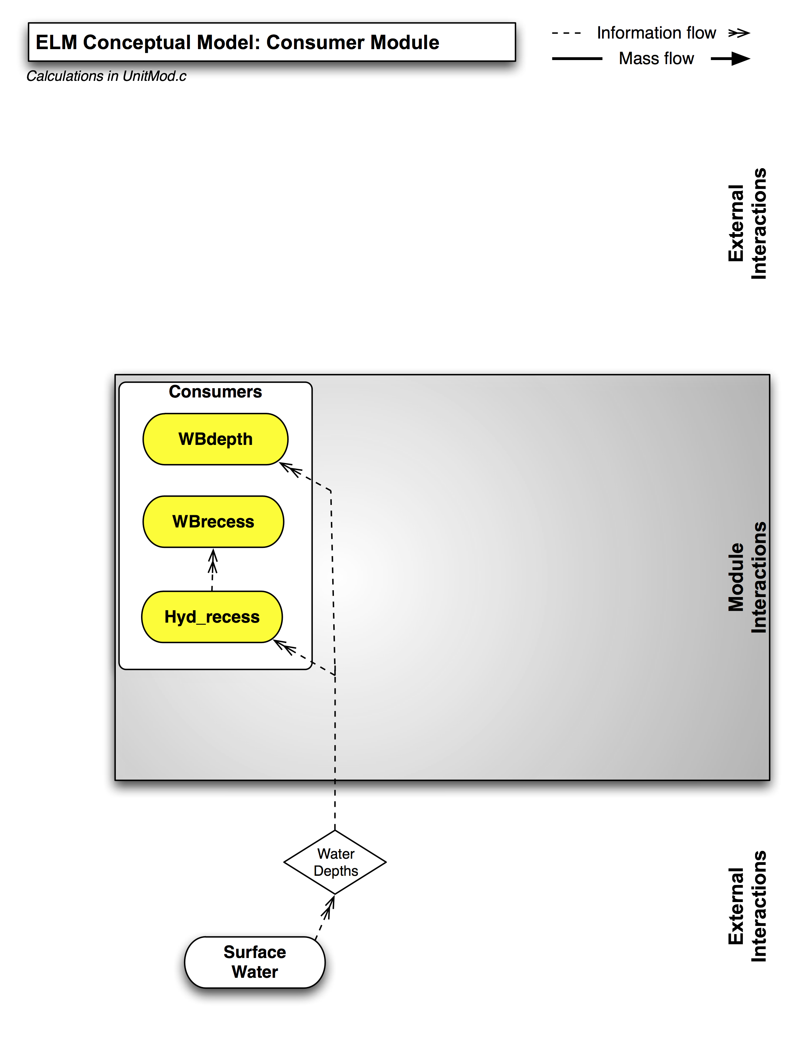
ELMwca2a Application: Consumer Module

Slide 6
Future Scenarios: Water Management
Stage regulation methods
Inflow sources: STA-2, S-10A-E
Outflow sources: S-11A-C, S144-146
Evaluate time-varying Target stage (NGVD ‘29) at WCA-2A 2-17 gauge
Inflow when stage < (Target - Offset) {2 cm Offset}
Outflow when stage > (Target + Offset) {2 cm Offset}
All Inflow magnitudes assume unlimited sources (i.e., no limits of water availability, or water quality, for inflows)
All Outflow magnitudes assume unconstrained flows allowed into receiving basins (i.e., no limits to water outflows)
The “Bird_structOnly” run has no rainfall, ET, or groundwater inflows/outflows – thus represents the rate at which the basin can be managed to meet the stage Target w/o natural variability.

Slide 7
Scenarios
Bird_structOnly
No natural nor SFWMM boundary conditions (i.e., no rainfall, ET, structure, nor groundwater flows)
Only ELM-calculated water control structure flows have inflow into/out-of the model domain
BASE2010
All water management driven by SFWMM v6.6 2010BASE
birdSched
ELM-calculated water control structure flows, using the proposed water management schedule for 2-17 gauge
SFWMM v6.6 2010BASE stage boundary conditions (drives any groundwater flows)
currentSched
ELM-calculated water control structure flows, using the current water management schedule for 2-17 gauge
SFWMM v6.6 2010BASE stage boundary conditions (drives any groundwater flows)

Slide 8
Scenarios

Slide 9
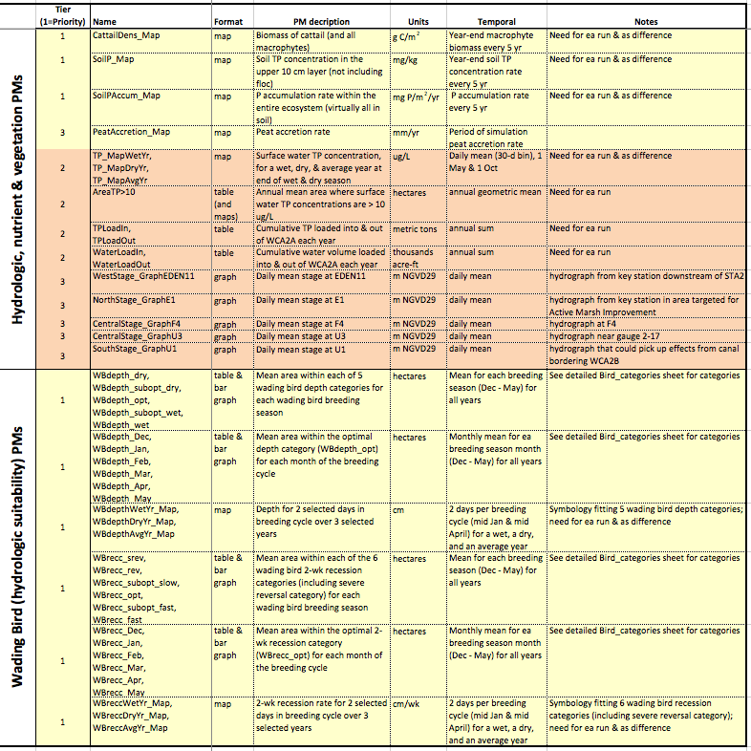
Performance Measures: All

Slide 10
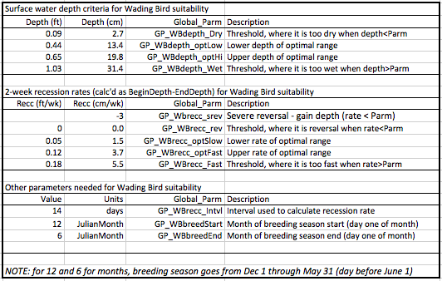
Performance Measures: Bird Parameters

Slide 11
Water Management – 2-17 Gauge (20 yr)
Simulated stage at the WCA-2A 2-17 gauge under the
-- historical calibration run (what "really" happened),
-- 2010 Base run (what "would have" happened if current ops etc. were used), and
-- current stage regulation schedule target at the 2-17 gauge

Slide 12
Water Management – 2-17 Gauge (36yr)

Slide 13
Water Management – 2-17 Gauge (5 of 36 yr)

Slide 14
Basin Water Budgets, 2010BASE vs CurrentSchedule (36yr)

Slide 15
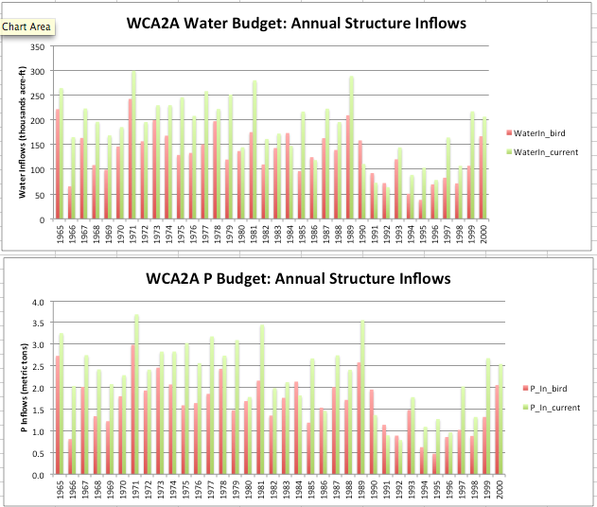
Annual Basin Budgets, CurrentSchedule vs BirdSchedule

Slide 16
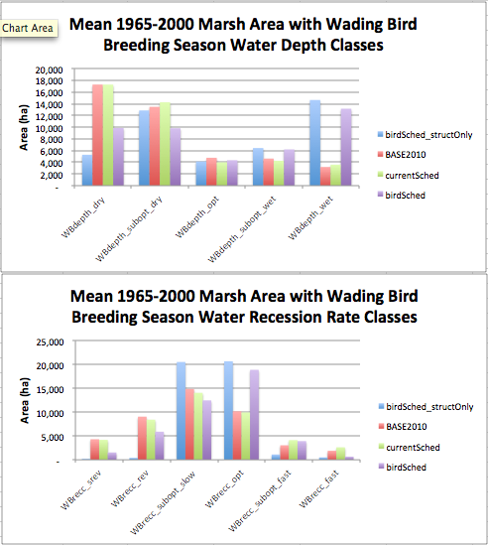
Wading Bird Performance Measure Summary: Annual

Slide 17
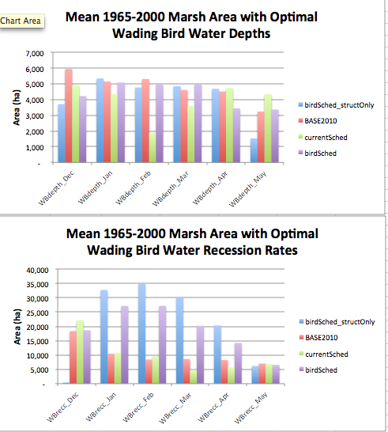
Wading Bird Performance Measure Summary: Monthly

Slide 18
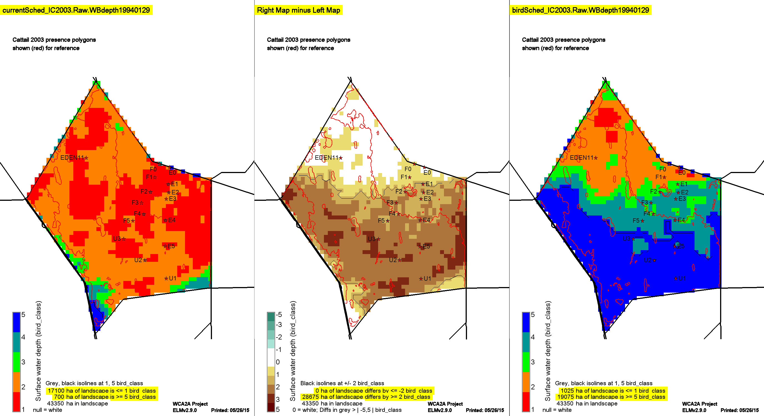
Example Bird Performance Measure: Depth Classes
Map header (yellow highlight) label-syntax: ScenarioName.TemporalStatistic.VariableName_DateOfOutput;
the temporal statistics are either Raw (raw output, no summary), MeanRaw (daily mean over a 30d bin), MeanPOS (mean over the 36yr Period Of Simulation), GeoMeanAnn (annual geometric mean), or for calculated rates - the rate between a beginning-date and ending-date (for P accumulation and peat accretion rates).
CurrentSched Bird – Current BirdSched
Yellow/Brown Difference =
BirdSched higher than CurrentSched

Slide 19
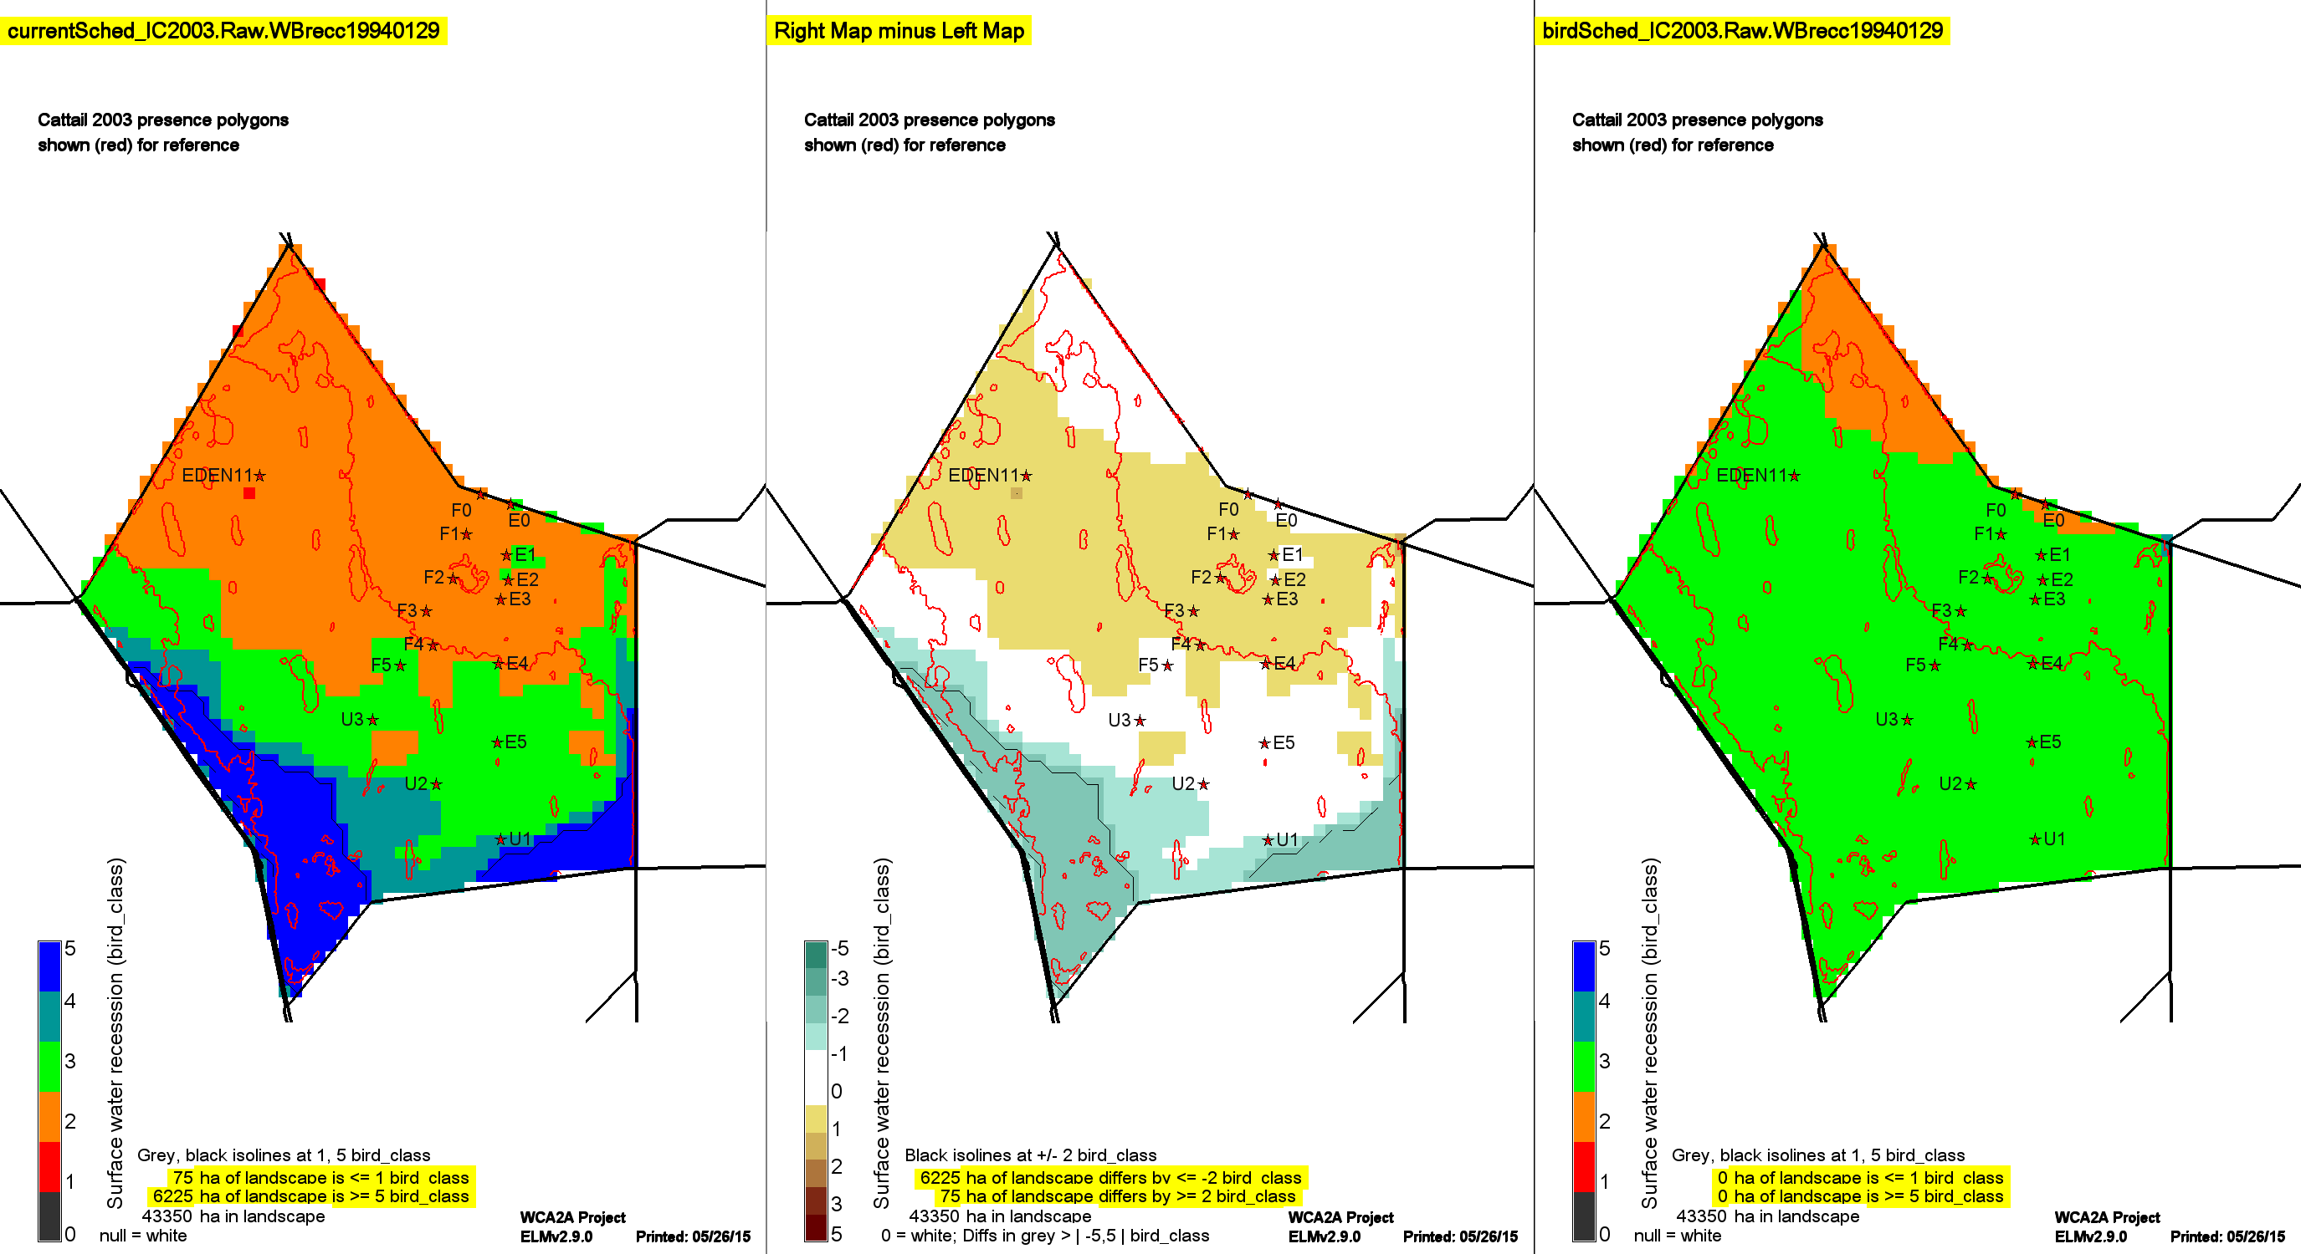
Example Bird Performance Measure: Recession Rate Classes
CurrentSched Bird – Current BirdSched
Yellow/Brown Difference =
BirdSched higher than CurrentSched

Slide 20
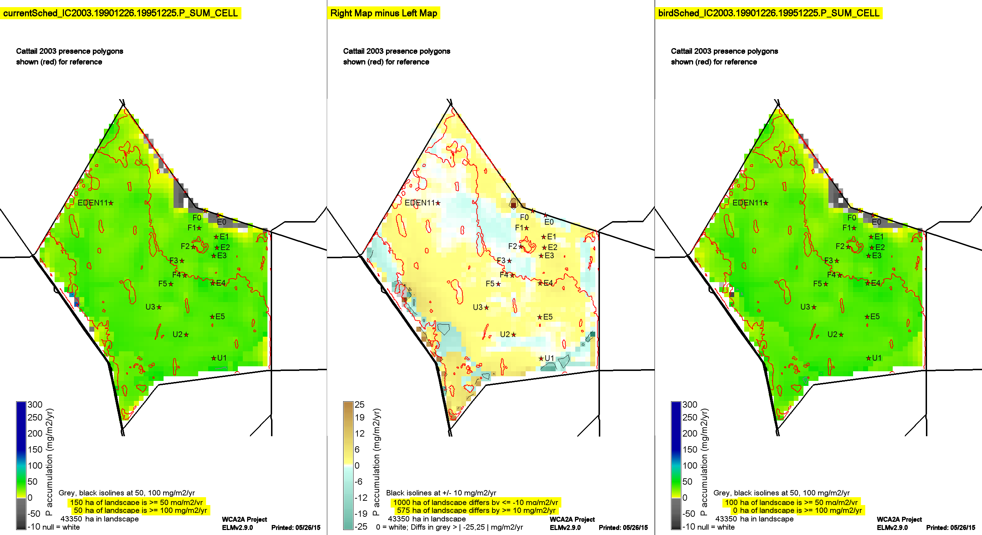
Example Other-Eco Performance Measure: P Accumulation
CurrentSched Bird – Current BirdSched
Yellow/Brown Difference =
BirdSched higher than CurrentSched

Slide 21
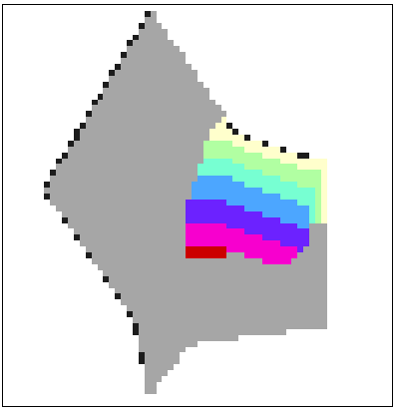
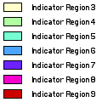
P Accumulation: reflux from high initial-P soils
Downstream
Upstream
Basin-wide atmospheric
load =
25 mg/m²/yr

Slide 22
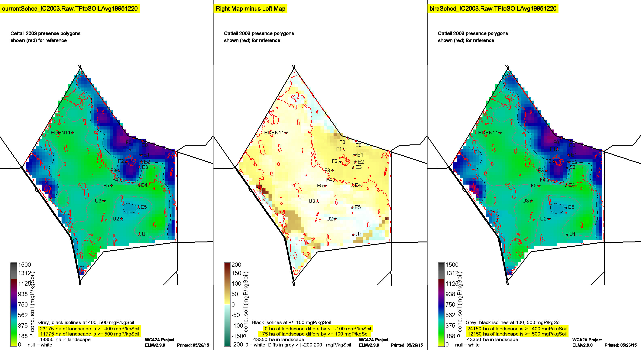
Example Other-Eco Performance Measure: Soil P Concentration
CurrentSched Bird – Current BirdSched
Yellow/Brown Difference =
BirdSched higher than CurrentSched

Slide 23
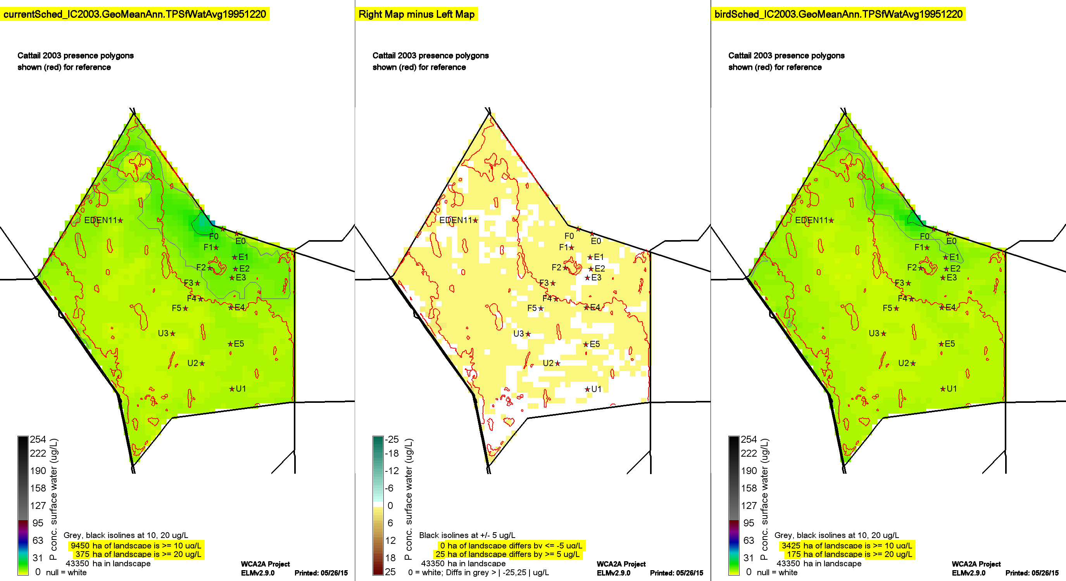
Example Other-Eco Performance Measure: Surface Water P Concentration
CurrentSched Bird – Current BirdSched
Yellow/Brown Difference =
BirdSched higher than CurrentSched

Slide 24
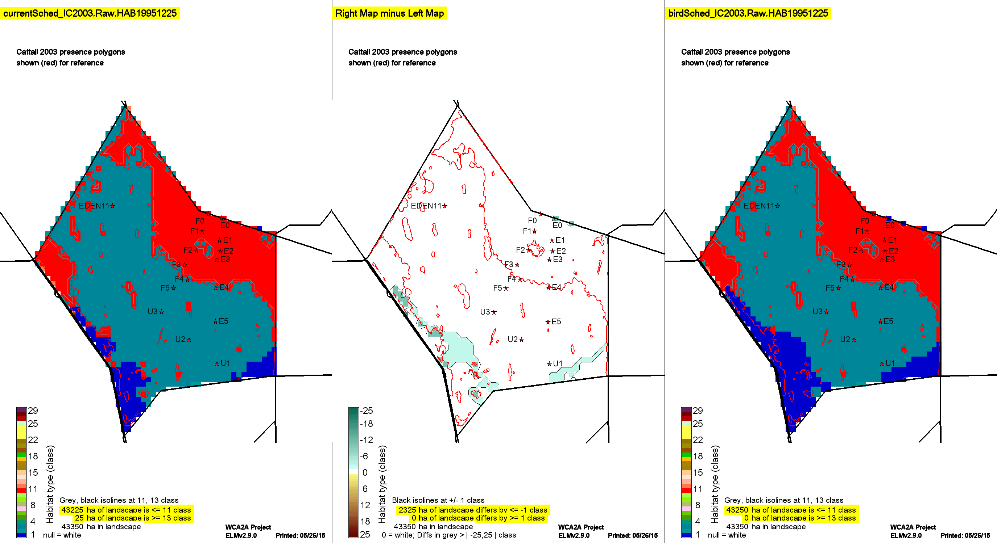
Example Other-Eco Performance Measure: Habitat Type
CurrentSched Bird – Current BirdSched
Yellow/Brown Difference =
BirdSched higher than CurrentSched

Slide 25
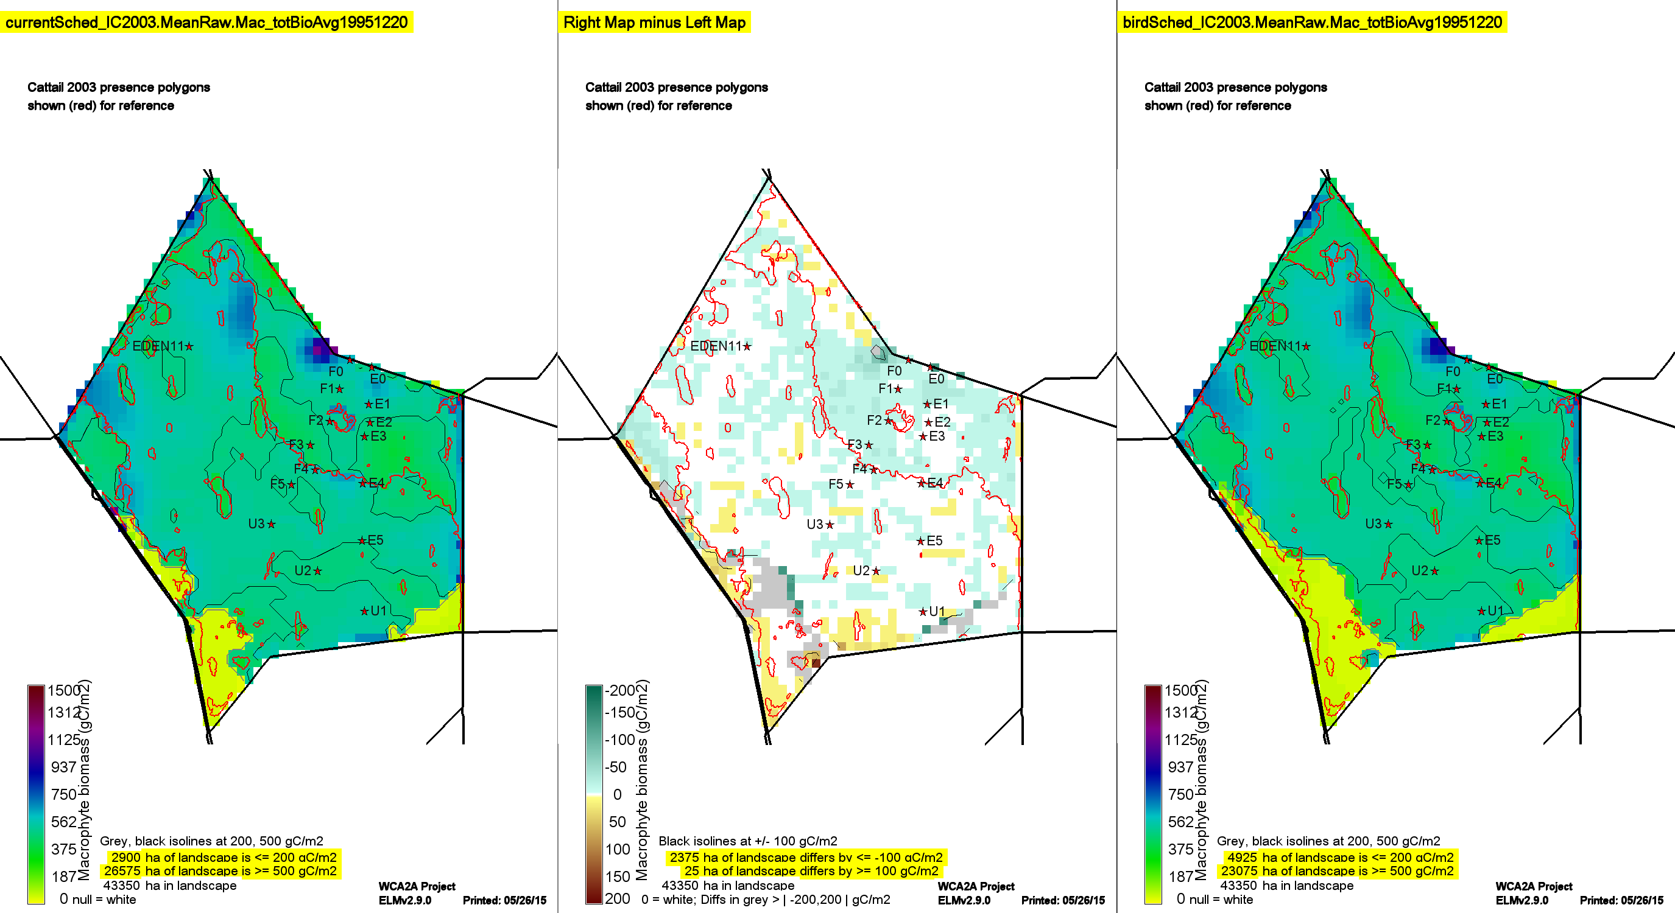
Example Other-Eco Performance Measure: Macrophyte Biomass
CurrentSched Bird – Current BirdSched
Yellow/Brown Difference =
BirdSched higher than CurrentSched

Slide 26
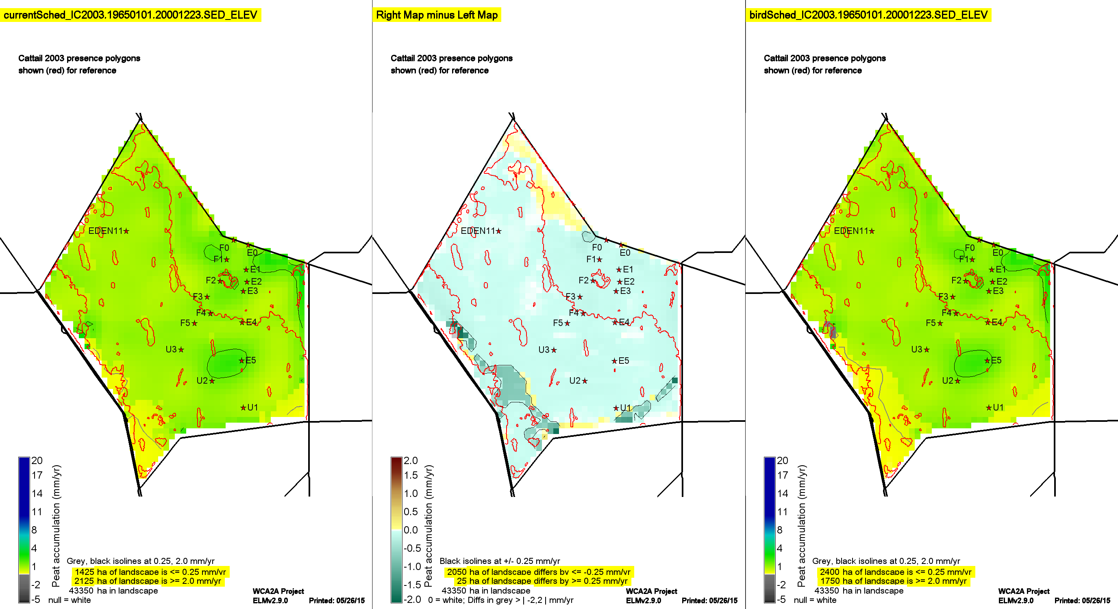
Example Other-Eco Performance Measure: Peat accretion
CurrentSched Bird – Current BirdSched
Yellow/Brown Difference =
BirdSched higher than CurrentSched

Slide 27
Wading Bird Suitability Project: General Observations
Current Schedule vs. SFWMM 2010 Base
Base had 3X more water flows into-out-of basin than necessary for maintaining 2-17 gauge regulation stage
Those flows associated with outflows to NE WCA-3A
Bird Schedule vs. Current Schedule
BirdSched requires less total water
BirdSched generally more suitable recession rates, but generally less suitable (deeper) depths
… but those deeper depths probably more suitable to support other ecosystem dynamics…
Both generally similar regarding phosphorus, soils, & vegetation
Future development/application
Improve depth distributions (& wading bird suitability) by using stage targets in north & south (instead of 1 central gauge)
Incorporate “hooks” to affect birds by vegetation density, fish indices (planning to incorporate Trexler stat model)
Make regional evaluations of bird suitability

